Slide 1
Objectives
  Explain the concept of a SAS data library.
  State the difference between a permanent library and a temporary library.
  Use the CONTENTS procedure to investigate a SAS data library.

Slide 2

SAS Data Libraries
A SAS data library is a collection of SAS files that are recognized as a unit by SAS.
z/OS (OS/390) A SAS data library is an operating system file.
SAS Data Library
z/OS (OS/390): userid.mysas.files
Directory-based A SAS data library is
Systems a directory.
SAS File
SAS File
SAS File
Windows: c:\mysasfiles
UNIX: /users/dept/mysasfiles
A SAS data set is a type of SAS file.

Slide 3
SAS Data Libraries
You can think of a SAS data library as a drawer in a filing cabinet and a SAS data set as one of the file folders in the drawer.
FILES
LIBRARIES
Notes:
PROG1/02s04f01.wmf

Slide 4
Assigning a Libref
Regardless of which host operating system you use, you identify SAS data libraries by assigning each a library reference name (libref).
libref
Notes:
PROG1/02s04f02.wmf

Slide 5
SAS Data Libraries
When you invoke SAS, you automatically have access to a temporary and a permanent SAS data library.
work - temporary library
sasuser - permanent library
work
sasuser
ia - permanent library
ia
You can create and access your own permanent libraries.

Slide 6
Assigning a Libref
You can use the LIBNAME statement to assign a libref to a SAS data library.
General form of the LIBNAME statement:
LIBNAME libref 'SAS-data-library' <options>;
Rules for naming a libref:
  must be 8 characters or less
  must begin with a letter or underscore
  remaining characters are letters, numbers, or underscores.

Slide 7
Assigning a Libref
Examples:
Windows
UNIX
z/OS (OS/390)
libname ia 'c:\workshop\winsas\prog1';
libname ia '/users/userid';
libname ia 'userid.prog1.sasdata' disp=shr;

Slide 8


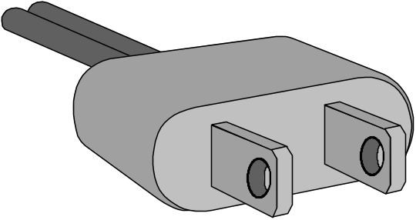
Making the Connection
When you submit the LIBNAME statement, a connection is made between a libref in SAS and the physical location of files on your operating system.
Windows 'c:\workshop\winsas\prog1'
UNIX '/users/userid'
z/OS (OS/390) 'userid.prog1.sasdata'

Slide 9
Two-level SAS Filenames
Every SAS file has a two-level name:
libref.filename
The data set ia.sales is a SAS file in the ia library.
  The first name (libref) refers to the library.
work
sasuser
sales
The second name (filename) refers to the file in the library.
ia

Slide 10
Temporary SAS Filename
The libref work can be omitted when you refer to a file in the work library. The default libref is work if the libref is omitted.
work.employee
employee

Slide 11
Browsing a SAS Data Library
During an interactive SAS session, the LIBNAME window enables you to investigate the contents of a
SAS data library.
In the LIBNAME window, you can
  view a list of all the libraries available during your current SAS session
  drill down to see all members of a specific library
  display the descriptor portion of a SAS data set.

Slide 12
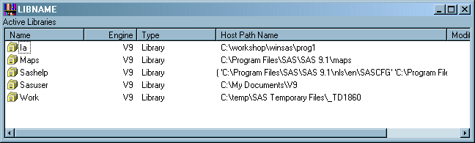
LIBNAME Window: Windows

Slide 13
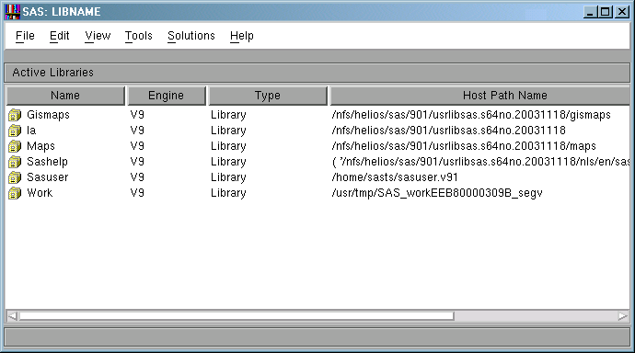
LIBNAME Window: UNIX

Slide 14
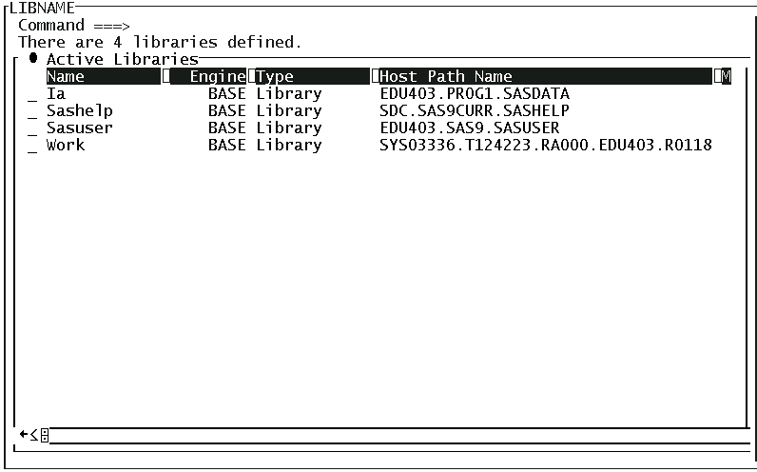
LIBNAME Window: z/OS (OS/390)

Slide 15
Browsing a SAS Data Library
Use the _ALL_ keyword to list all the SAS files in the library and the NODS option to suppress the descriptor portions of the data sets.
General form of the NODS option:
NODS must be used in conjunction with the keyword _ALL_.
PROC CONTENTS DATA=libref._ALL_ NODS;
RUN;
proc contents data=ia._all_ nods;
run;
c03s1d1

Slide 16
PROC CONTENTS Output
Partial Output
The SAS System
The CONTENTS Procedure
Directory
Libref IA
Engine V9
Physical Name C:\workshop\winsas\prog1
File Name C:\workshop\winsas\prog1
Member File
# Name Type Size Last Modified
1 ALLGOALS DATA 5120 31Jul01:08:52:34
2 ALLGOALS2 DATA 5120 31Jul01:08:52:38
3 ALLSALES DATA 5120 31Jul01:08:53:28
4 ALLSALES2 DATA 5120 31Jul01:08:53:46
5 APRTARGET DATA 17408 13Aug01:08:41:42
6 CHICAGO DATA 17408 31Jul01:08:54:38
7 CREW DATA 13312 31Jul01:08:54:44
8 DELAY DATA 66560 31Jul01:08:54:46

Slide 17
Browsing a SAS Data Library
To explore the descriptor portion of a SAS data set, specify the data set name in the DATA= option.
PROC CONTENTS DATA=libref.SAS-data-set-name;
RUN;
proc contents data=ia.crew;
run;
c03s1d1

Slide 18
PROC CONTENTS Output – Part 1
The SAS System
The CONTENTS Procedure
Data Set Name IA.CREW Observations 69
Member Type DATA Variables 8
Engine V9 Indexes 0
Created Friday, June 29, Observation Length 120
2001 03:15:27 PM
Last Modified Friday, June 29, Deleted Observations 0
2001 03:41:07 PM
Protection Compressed NO
Data Set Type Sorted NO
Label
Data Representation WINDOWS_32
Encoding Default

Slide 19
PROC CONTENTS Output – Part 2
Engine/Host Dependent Information
Data Set Page Size 12288
Number of Data Set Pages 1
First Data Page 1
Max Obs per Page 102
Obs in First Data Page 69
Number of Data Set Repairs 0
File Name C:\workshop\winsas\
prog1\crew.sas7bdat
Release Created 8.0202M0
Host Created WIN_PRO

Slide 20
PROC CONTENTS Output – Part 3
Alphabetic List of Variables and Attributes
# Variable Type Len Format Informat
6 EmpID Char 6
3 FirstName Char 32
1 HireDate Num 8 DATE9. DATE9.
7 JobCode Char 6
2 LastName Char 32
4 Location Char 16
5 Phone Char 8
8 Salary Num 8

Slide 21

Exercises
This exercise reinforces the concepts discussed previously.

